Slide 2
What is knowledge representation?
Humans are best at understanding, reasoning, and interpreting knowledge.
Human knows things, which is knowledge and as per their knowledge they perform various actions in the real world.
But how machines do all these things comes under knowledge representation and reasoning
Hence we can describe Knowledge representation as following:

Slide 3
What is knowledge representation?
Knowledge representation and reasoning (KR, KRR) is the part of Artificial intelligence which concerned with AI agents thinking and how thinking contributes to intelligent behavior of agents.
It is responsible for representing information about the real world so that a computer can understand and can utilize this knowledge to solve the complex real world problems such as diagnosis a medical condition or communicating with humans in natural language.
It is also a way which describes how we can represent knowledge in artificial intelligence. Knowledge representation is not just storing data into some database, but it also enables an intelligent machine to learn from that knowledge and experiences so that it can behave intelligently like a human.

Slide 4
What to Represent:
Following are the kind of knowledge which needs to be represented in AI systems:
Object: All the facts about objects in our world domain. E.g., Guitars contains strings, trumpets are brass instruments.
Events: Events are the actions which occur in our world.
Performance: It describe behavior which involves knowledge about how to do things.
Meta-knowledge: It is knowledge about what we know.
Facts: Facts are the truths about the real world and what we represent.
Knowledge-Base: The central component of the knowledge-based agents is the knowledge base. It is represented as KB. The Knowledgebase is a group of the Sentences (Here, sentences are used as a technical term and not identical with the English language).

Slide 5
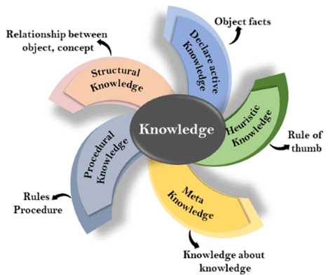
Types of knowledge
Knowledge: Knowledge is awareness or familiarity gained by experiences of facts, data, and situations. Following are the types of knowledge in artificial intelligence:

Slide 6
Types of knowledge
Declarative Knowledge:
Declarative knowledge is to know about something.
It includes concepts, facts, and objects.
It is also called descriptive knowledge and expressed in declarative sentences.
It is simpler than procedural language.

Slide 7
Types of knowledge
Procedural Knowledge
It is also known as imperative knowledge.
Procedural knowledge is a type of knowledge which is responsible for knowing how to do something.
It can be directly applied to any task.
It includes rules, strategies, procedures, agendas, etc.
Procedural knowledge depends on the task on which it can be applied.

Slide 8
Types of knowledge
3. Meta-knowledge:
Knowledge about the other types of knowledge is called Meta-knowledge.
4. Heuristic knowledge:
Heuristic knowledge is representing knowledge of some experts in a filed or subject.
Heuristic knowledge is rules of thumb based on previous experiences, awareness of approaches, and which are good to work but not guaranteed.

Slide 9
Types of knowledge
Structural knowledge:
Structural knowledge is basic knowledge to problem-solving.
It describes relationships between various concepts such as kind of, part of, and grouping of something.
It describes the relationship that exists between concepts or objects.

Slide 10
The relation between knowledge and intelligence:
Knowledge of real-worlds plays a vital role in intelligence and same for creating artificial intelligence.
Knowledge plays an important role in demonstrating intelligent behavior in AI agents.
An agent is only able to accurately act on some input when he has some knowledge or experience about that input.

Slide 11
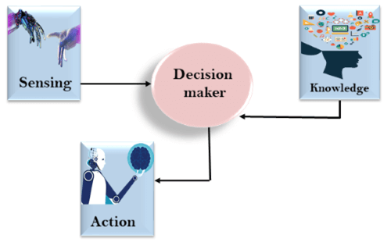

Slide 12
AI knowledge cycle:
An Artificial intelligence system has the following components for displaying intelligent behavior:
Perception
Learning
Knowledge Representation and Reasoning
Planning
Execution

Slide 13
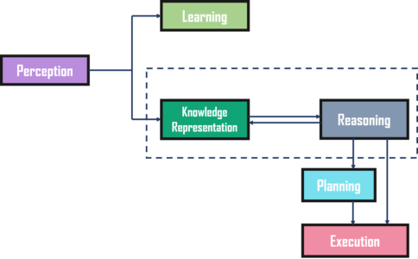

Slide 14
Approaches to knowledge representation:
There are mainly four approaches to knowledge representation, which are given below.
Simple relational knowledge:
It is the simplest way of storing facts which uses the relational method, and each fact about a set of the object is set out systematically in columns.
This approach of knowledge representation is famous in database systems where the relationship between different entities is represented.
This approach has little opportunity for inference.

Slide 15
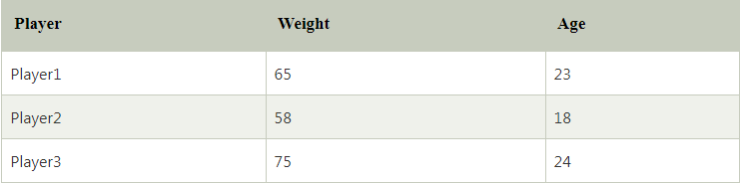
Example: The following is the simple relational knowledge representation.

Slide 16
Inheritable knowledge:
In the inheritable knowledge approach, all data must be stored into a hierarchy of classes.
All classes should be arranged in a generalized form or a hierarchal manner.
In this approach, we apply inheritance property.
Elements inherit values from other members of a class.
This approach contains inheritable knowledge which shows a relation between instance and class, and it is called instance relation.
Every individual frame can represent the collection of attributes and its value.
In this approach, objects and values are represented in Boxed nodes.
We use Arrows which point from objects to their values.

Slide 17
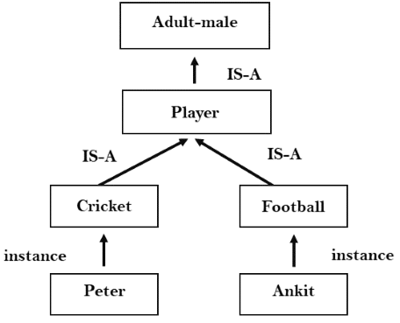

Slide 18
Inferential knowledge:
Inferential knowledge approach represents knowledge in the form of formal logics.
This approach can be used to derive more facts.
It guaranteed correctness.
Example: Let's suppose there are two statements:
Marcus is a man
All men are mortal Then it can represent as;
man(Marcus) ∀x = man (x) ----------> mortal (x)s

Slide 19
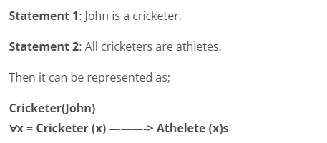

Slide 20
Procedural knowledge:
Procedural knowledge approach uses small programs and codes which describes how to do specific things, and how to proceed.
In this approach, one important rule is used which is If-Then rule.
In this knowledge, we can use various coding languages such as LISP language and Prolog language.
We can easily represent heuristic or domain-specific knowledge using this approach.
But it is not necessary that we can represent all cases in this approach.

Slide 21
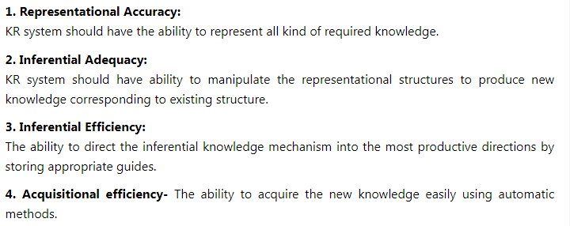
Requirements for knowledge Representation system:
A good knowledge representation system must possess the following properties.

Slide 22
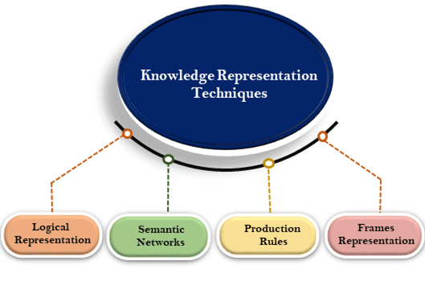
Techniques of knowledge representation
There are mainly four ways of knowledge representation which are given as follows:
Logical Representation
Semantic Network Representation
Frame Representation
Production Rules

Slide 23
Logical Representation
Logical representation is a language with some concrete rules which deals with propositions and has no ambiguity in representation.
Logical representation means drawing a conclusion based on various conditions.
This representation lays down some important communication rules.
It consists of precisely defined syntax and semantics which supports the sound inference.
Each sentence can be translated into logics using syntax and semantics.

Slide 24
Logical Representation
Syntax:
Syntaxes are the rules which decide how we can construct legal sentences in the logic.
It determines which symbol we can use in knowledge representation.
How to write those symbols.
Semantics:
Semantics are the rules by which we can interpret the sentence in the logic.
Semantic also involves assigning a meaning to each sentence.

Slide 25
Logical Representation
Logical representation can be categorised into mainly two logics:
Propositional Logics
Predicate logics

Slide 26
Logical Representation
Advantages of logical representation:
Logical representation enables us to do logical reasoning.
Logical representation is the basis for the programming languages.
Disadvantages of logical Representation:
Logical representations have some restrictions and are challenging to work with.
Logical representation technique may not be very natural, and inference may not be so efficient.

Slide 27
Semantic Network Representation
Semantic networks are alternative of predicate logic for knowledge representation.
In Semantic networks, we can represent our knowledge in the form of graphical networks.
This network consists of nodes representing objects and arcs which describe the relationship between those objects.
Semantic networks can categorize the object in different forms and can also link those objects.
Semantic networks are easy to understand and can be easily extended.

Slide 28
This representation consist of mainly two types of relations:
IS-A relation (Inheritance)
Kind-of-relation
Example: Following are some statements which we need to represent in the form of nodes and arcs.
Statements:
Jerry is a cat.
Jerry is a mammal
Jerry is owned by Priya.
Jerry is brown colored.
All Mammals are animal.

Slide 29
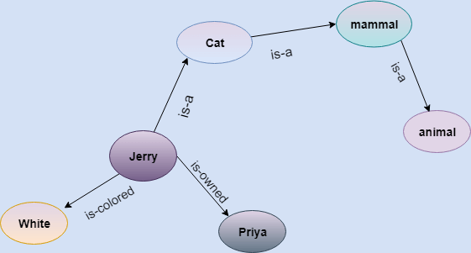
In the above diagram, we have represented the different type of knowledge in the form of nodes and arcs. Each object is connected with another object by some relation.

Slide 30
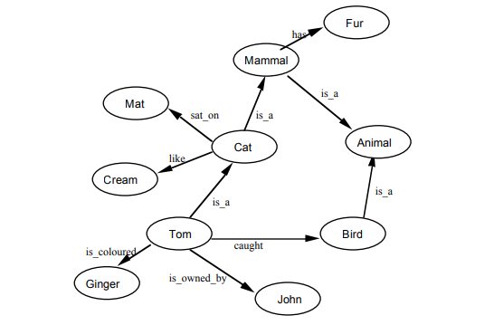

Slide 31
Drawbacks in Semantic representation:
Semantic networks take more computational time at runtime as we need to traverse the complete network tree to answer some questions.
It might be possible in the worst case scenario that after traversing the entire tree, we find that the solution does not exist in this network
Semantic networks try to model human-like memory (Which has 10¹⁵ neurons and links) to store the information, but in practice, it is not possible to build such a vast semantic network.
These types of representations are inadequate as they do not have any equivalent quantifier, e.g., for all, for some, none, etc.

Slide 32
Drawbacks in Semantic representation:
Semantic networks do not have any standard definition for the link names.
These networks are not intelligent and depend on the creator of the system.

Slide 33
Advantages of Semantic network:
Semantic networks are a natural representation of knowledge.
Semantic networks convey meaning in a transparent manner.
These networks are simple and easily understandable.

Slide 34
Frame Representation
A frame is a record like structure which consists of a collection of attributes and its values to describe an entity in the world.
Frames are the AI data structure which divides knowledge into substructures by representing stereotypes situations.
It consists of a collection of slots and slot values.
These slots may be of any type and sizes.
Slots have names and values which are called facets.

Slide 35
Frame Representation
Facets: The various aspects of a slot is known as Facets. Facets are features of frames which enable us to put constraints on the frames.
Example: IF-NEEDED facts are called when data of any particular slot is needed.
A frame may consist of any number of slots, and a slot may include any number of facets and facets may have any number of values.
A frame is also known as slot-filter knowledge representation in artificial intelligence.

Slide 36
Frame Representation
Frames are derived from semantic networks and later evolved into our modern-day classes and objects.
A single frame is not much useful.
Frames system consist of a collection of frames which are connected. In the frame, knowledge about an object or event can be stored together in the knowledge base.
The frame is a type of technology which is widely used in various applications including Natural language processing and machine visions.

Slide 37
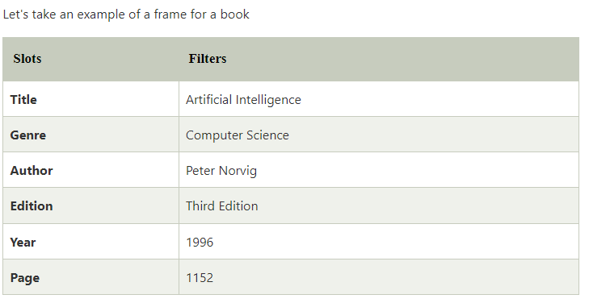
Example: 1

Slide 38
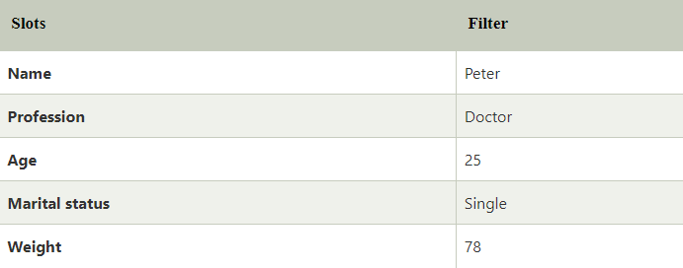
Example 2:
Let's suppose we are taking an entity, Peter. Peter is an engineer as a profession, and his age is 25, he lives in city London, and the country is England. So following is the frame representation for this:

Slide 39
Advantages of frame representation:
The frame knowledge representation makes the programming easier by grouping the related data.
The frame representation is comparably flexible and used by many applications in AI.
It is very easy to add slots for new attribute and relations.
It is easy to include default data and to search for missing values.
Frame representation is easy to understand and visualize.

Slide 40
Disadvantages of frame representation:
In frame system inference mechanism is not be easily processed.
Inference mechanism cannot be smoothly proceeded by frame representation.
Frame representation has a much generalized approach.

Slide 41
Production Rules
Production rules system consist of (condition, action) pairs which mean, "If condition then action". It has mainly three parts
The set of production rules
Working Memory
The recognize-act-cycle

Slide 42
Production Rules
In production rules agent checks for the condition and if the condition exists then production rule fires and corresponding action is carried out.
The condition part of the rule determines which rule may be applied to a problem.
And the action part carries out the associated problem-solving steps.
This complete process is called a recognize-act cycle.
The working memory contains the description of the current state of problems-solving and rule can write knowledge to the working memory.
This knowledge match and may fire other rules.

Slide 43
Production Rules
If there is a new situation (state) generates, then multiple production rules will be fired together, this is called conflict set.
In this situation, the agent needs to select a rule from these sets, and it is called a conflict resolution.

Slide 44
Example:
IF (at bus stop AND bus arrives) THEN action (get into the bus)
IF (on the bus AND paid AND empty seat) THEN action (sit down).
IF (on bus AND unpaid) THEN action (pay charges).
IF (bus arrives at destination) THEN action (get down from the bus).

Slide 45
Advantages of Production rule:
The production rules are expressed in natural language.
The production rules are highly modular, so we can easily remove, add or modify an individual rule.

Slide 46
Disadvantages of Production rule:
Production rule system does not exhibit any learning capabilities, as it does not store the result of the problem for the future uses.
During the execution of the program, many rules may be active hence rule-based production systems are inefficient.

Slide 47
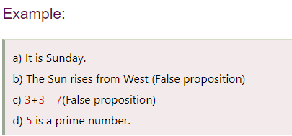
Propositional logic in Artificial intelligence
Propositional logic (PL) is the simplest form of logic where all the statements are made by propositions.
A proposition is a declarative statement which is either true or false.
It is a technique of knowledge representation in logical and mathematical form.

Slide 48
Following are some basic facts about propositional logic:
Propositional logic is also called Boolean logic as it works on 0 and 1.
In propositional logic, we use symbolic variables to represent the logic, and we can use any symbol for a representing a proposition, such A, B, C, P, Q, R, etc.
Propositions can be either true or false, but it cannot be both.
Propositional logic consists of an object, relations or function, and logical connectives.
These connectives are also called logical operators.
The propositions and connectives are the basic elements of the propositional logic.
Connectives can be said as a logical operator which connects two sentences.

Slide 49
Following are some basic facts about propositional logic:
A proposition formula which is always true is called tautology, and it is also called a valid sentence.
A proposition formula which is always false is called Contradiction.
A proposition formula which has both true and false values is called
Statements which are questions, commands, or opinions are not propositions such as "Where is Rohini", "How are you", "What is your name", are not propositions.

Slide 50
Syntax of propositional logic:
The syntax of propositional logic defines the allowable sentences for the knowledge representation. There are two types of Propositions:
Atomic Propositions
Compound propositions
Atomic Proposition: Atomic propositions are the simple propositions. It consists of a single proposition symbol. These are the sentences which must be either true or false.

Slide 51
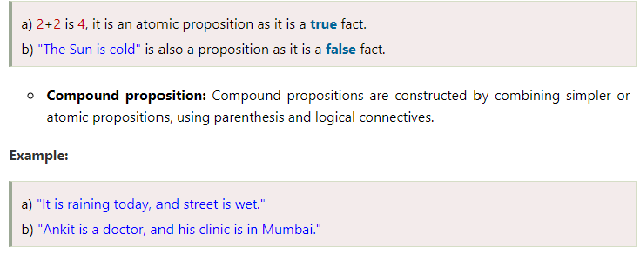

Slide 52
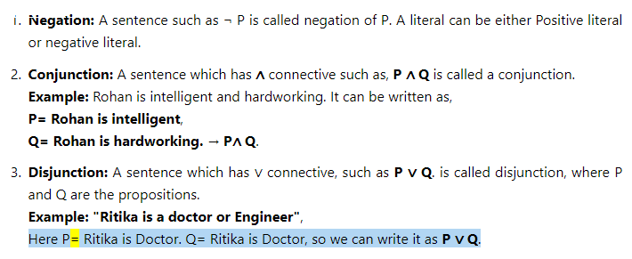
Logical Connectives:

Slide 53
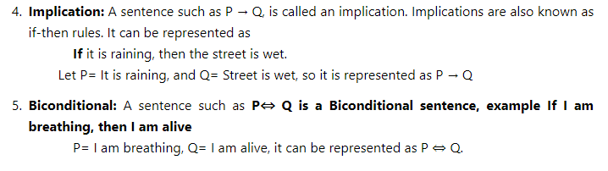
Logical Connectives:

Slide 54
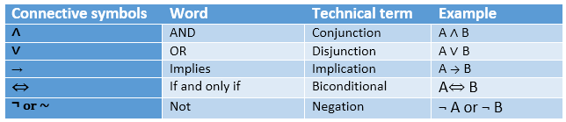

Slide 55
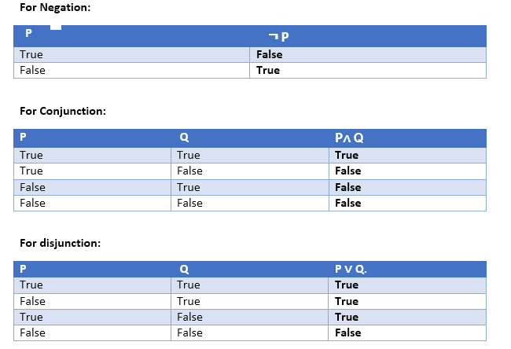
Truth Table:

Slide 56
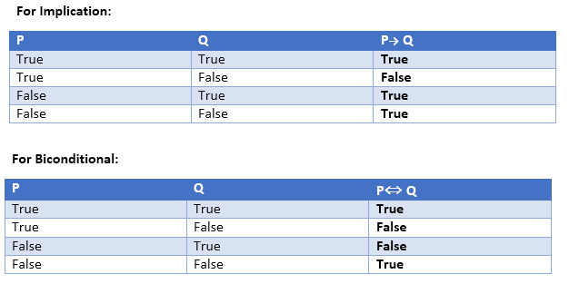

Slide 57
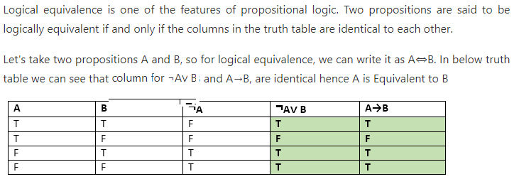
Logical equivalence:

Slide 58
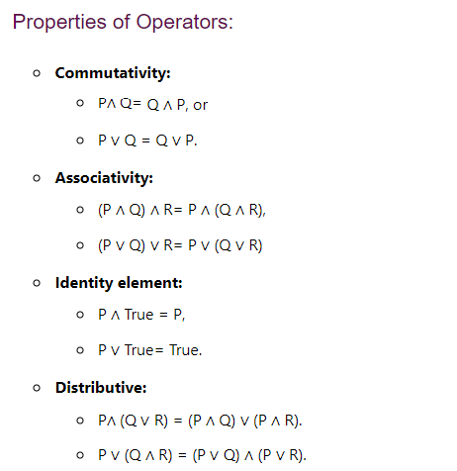
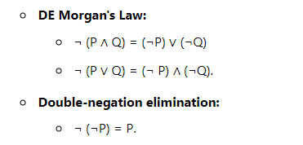

Slide 59
Limitations of Propositional logic:
We cannot represent relations like ALL, some, or none with propositional logic. Example:
All the girls are intelligent.
Some apples are sweet.
Propositional logic has limited expressive power.
In propositional logic, we cannot describe statements in terms of their properties or logical relationships.

Slide 60
USING PREDICATE LOGIC
Representation of Simple Facts in Logic.
Propositional logic is useful because it is simple to deal with and a decision procedure for it exists.
Also, In order to draw conclusions, facts are represented in a more convenient way as,
1. Marcus is a man. ----- man(Marcus)
2. Plato is a man.----------man(Plato)
3. All men are mortal.-------- mortal(men)

Slide 61
Predicate logic
First-order Predicate logic (FOPL) models the world in terms of
Objects, which are things with individual identities
Properties of objects that distinguish them from other objects
Relations that hold among sets of objects
Functions, which are a subset of relations where there is only one “value” for any given “input”

Slide 62
First-order Predicate logic (FOPL) provides
Constants: a, b, dog33. Name a specific object.
Variables: X, Y. Refer to an object without naming it.
Functions: Mapping from objects to objects.
Terms: Refer to objects
Atomic Sentences: in(dad-of(X), food6) Can be true or false, Correspond to propositional
symbols P, Q.
A well-formed formula (wff) is a sentence containing no “free” variables. So, That is, all
variables are “bound” by universal or existential quantifiers.
(∀x)P(x, y) has x bound as a universally quantified variable, but y is free

Slide 63
Quantifiers
Universal quantification
(∀x)P(x) means that P holds for all values of x in the domain associated with that variable
E.g., (∀x) dolphin(x) → mammal(x)
Existential quantification
(∃ x)P(x) means that P holds for some value of x in the domain associated with that variable
E.g., (∃ x) mammal(x) ∧ lays-eggs(x)

Slide 64
Consider the following example that shows the use of predicate logic as a way of representing knowledge.
1. Marcus was a man.
2. Marcus was a Pompeian.
3. All Pompeians were Romans.
4. Caesar was a ruler.
5. All Pompeians were either loyal to Caesar or hated him.
6. Everyone is loyal to someone.
8. Marcus tried to assassinate Caesar.

Slide 65
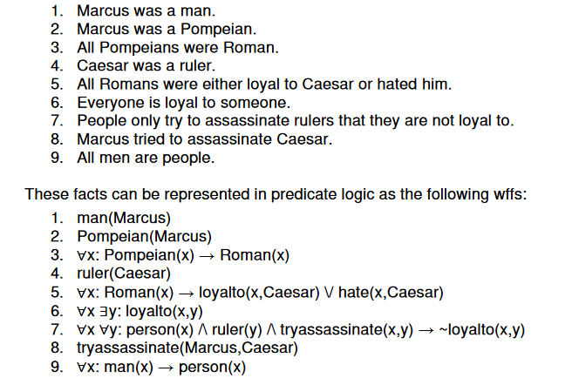

Slide 66
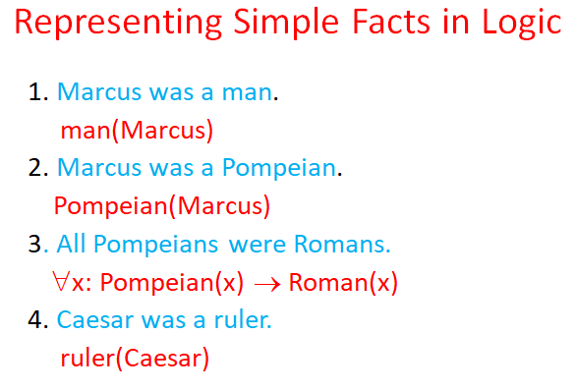

Slide 67
5. All Romans were either loyal to Caesar or hated him.
∀x: Roman(x) → loyalto(x, Caesar) ∨ hate(x, Caesar)
6. Every one is loyal to someone.
∀x: ∃y: loyalto(x, y)
7. People only try to assassinate rulers they are not loyal to.
∀x: ∀y: person(x) ∧ ruler(y) ∧ tryassassinate(x, y) → ¬ loyalto(x, y)
8. Marcus tried to assassinate Caesar.
tryassassinate(Marcus, Caesar)

Slide 68
Representing Instance and ISA Relationships
Specific attributes instance and isa play an important role particularly in a useful form of reasoning called property inheritance.
The predicates instance and isa explicitly captured the relationships they used to expres
Asserting that P(x) is true is equivalent to asserting that x is an instance (or element) of P.s, namely class membership and class inclusion.
Pompeian(Marcus) instance(Marcus, Pompeian)
∀x: Pompeian(x) → Roman(x)
∀x: instance(x, Pompeian) → instance(x, Roman)

Slide 69
Representing Instance and ISA Relationships
instance(Marcus, Pompeian) isa(Pompeian, Roman)
∀x: ∀y: ∀z: instance(x, y) ∧ isa(y, z) → instance(x, z)
The predicate instance is a binary one, whose first argument is an object and whose second argument is a class to which the object belongs.

Slide 70
Computable Functions and Predicates
To express simple facts, such as the following greater-than and less-than relationships:
gt(1,O) It(0,1) gt(2,1) It(1,2) gt(3,2) It( 2,3)
It is often also useful to have computable functions as well as computable predicates.
Thus we might want to be able to evaluate the truth of gt(2 + 3,1)

Slide 71
1. Marcus was born in 40 A.D.
born(Marcus, 40)
2. All Pompeians died when the volcano erupted in 79 A.D.
erupted(volcano, 79) ∧ ∀ x : [Pompeian(x) → died(x, 79)]
3. No mortal lives longer than 150 years.
∀ x: ∀ t1: ∀ t2: mortal(x) ∧ born(x, t1) ∧ gt(t2 – t1,150) → died(x, t2)
4. It is now 1991
now = 1991

Slide 72
Now suppose we want to answer the question “Is Marcus alive?
there may be two ways of deducing an answer
1. Either we can show that Marcus is dead because he was killed by the volcano
2. we can show that he must be dead because he would otherwise be more than 150 years old, which we know is not possible.
we need some additional knowledge. For example, our statements talk about dying, but they say nothing that relates to being alive, which is what the question is asking. So we add the following facts:
8) Alive means not dead.
∀x: ∀t: [alive(x, t) → ¬ dead(x, t)] ∧ [¬ dead(x, t) → alive(x, t)]
9) If someone dies, then he is dead at all later times.
∀x: ∀t1: ∀t2: died(x, t1) ∧ gt(t2, t1) → dead(x, t2)

Slide 73
Computable Functions and Predicates
Suppose we want to answer the question “Is Marcus alive now?”.
We can do this by either proving alive(Marcus,now) or ~alive(Marcus,now). Let us try the latter:

Slide 74
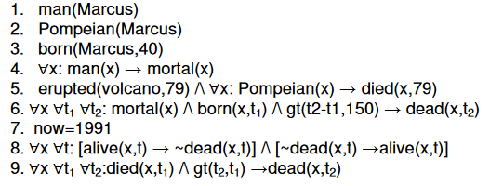
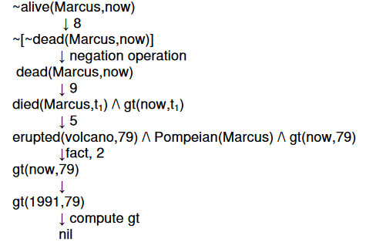

Slide 75
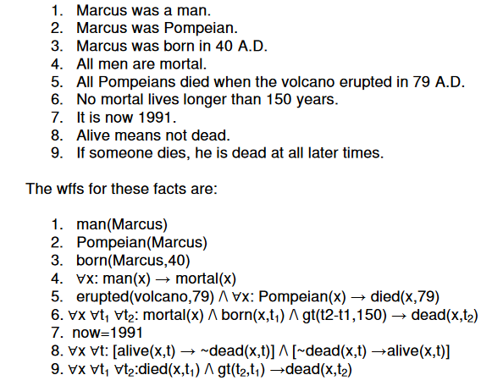

Slide 76
Rules of Inference in Artificial intelligence
Inference:
In artificial intelligence, we need intelligent computers which can create new logic from old logic or by evidence,
so generating the conclusions from evidence and facts is termed as Inference.

Slide 77
Rules of Inference in Artificial intelligence
Inference rules:
Inference rules are the templates for generating valid arguments. Inference rules are applied to derive proofs in artificial intelligence, and the proof is a sequence of the conclusion that leads to the desired goal.
In inference rules, the implication among all the connectives plays an important role. Following are some terminologies related to inference rules:
Implication: It is one of the logical connectives which can be represented as P → Q. It is a Boolean expression.
Converse: The converse of implication, which means the right-hand side proposition goes to the left-hand side and vice-versa. It can be written as Q → P.
Contrapositive: The negation of converse is termed as contrapositive, and it can be represented as ¬ Q → ¬ P.
Inverse: The negation of implication is called inverse. It can be represented as ¬ P → ¬ Q.

Slide 78
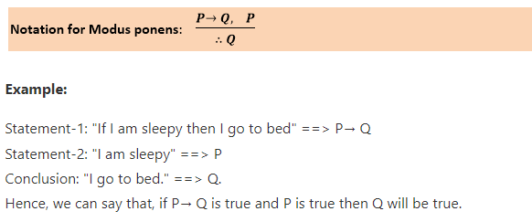
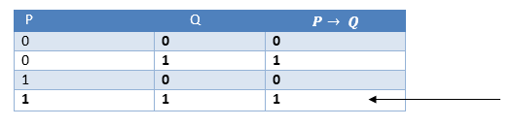
Types of Inference rules:
1. Modus Ponens:
The Modus Ponens rule is one of the most important rules of inference,and it states that if P and P → Q is true, then we can infer that Q will be true. It can be represented as:

Slide 79
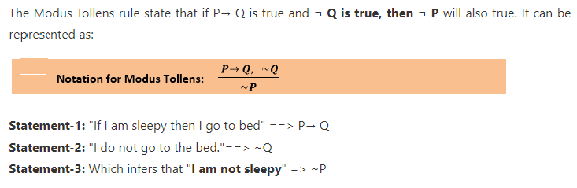
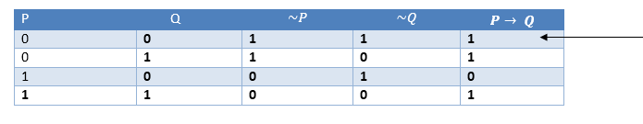
2. Modus Tollens:

Slide 80
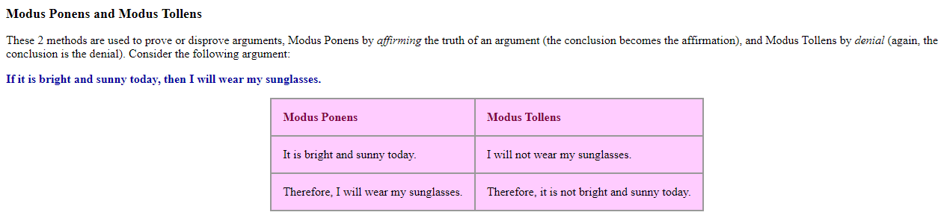

Slide 81
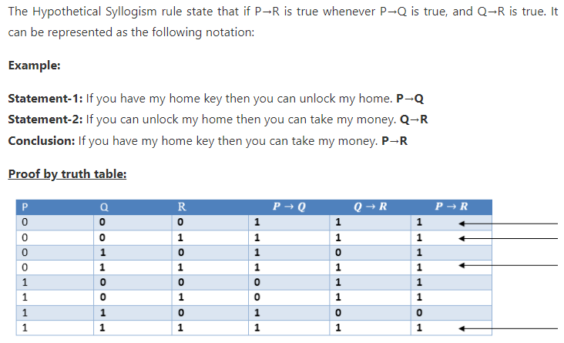
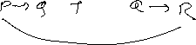
3. Hypothetical Syllogism:

Slide 82
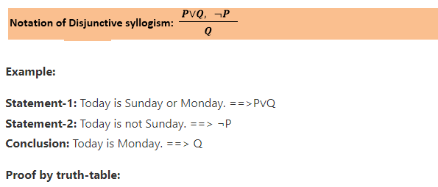
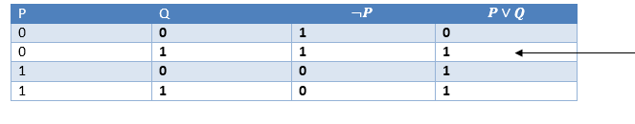
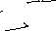
4. Disjunctive Syllogism:
The Disjunctive syllogism rule state that if P∨Q is true, and ¬P is true, then Q will be true. It can be represented as:

Slide 83
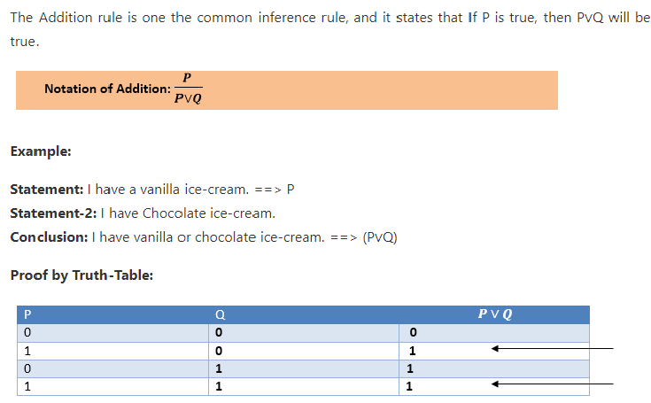
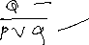
5. Addition:

Slide 84
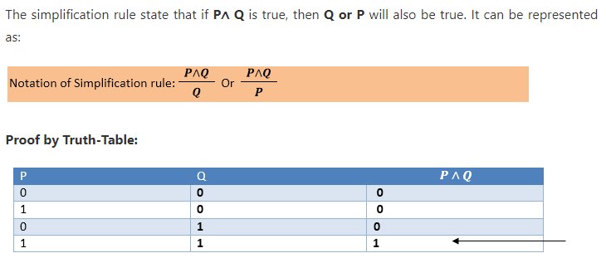
6. Simplification:

Slide 85
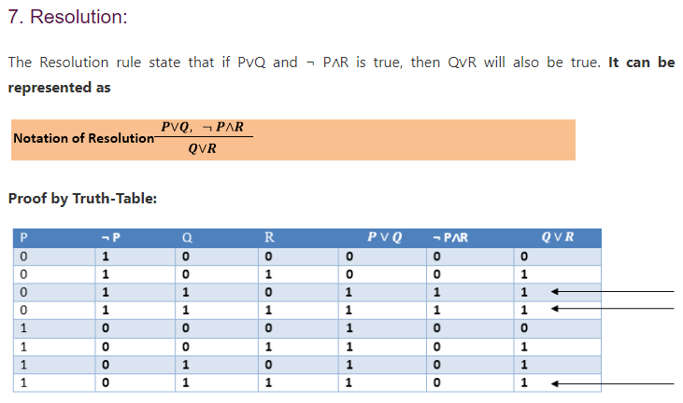

Slide 86
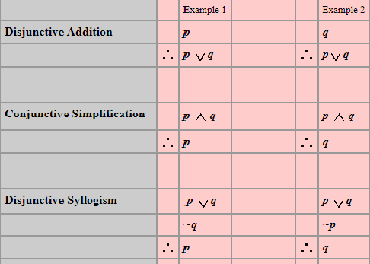

Slide 87
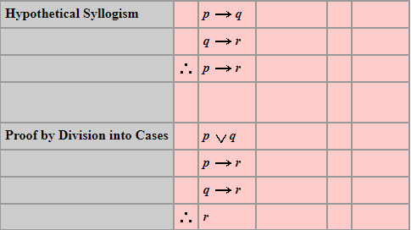

Slide 88
Example 2 : At the prolog query prompt, when you write below query,
?- owns(X, car(bmw)) = owns(Y, car(C)). You will get Answer : X = Y, C = bmw.
Here owns(X, car(bmw)) and owns(Y, car(C)) unifies -- because
predicate names 'owns' are same on both side
(ii) number of arguments for that predicate, i.e. 2, are equal both side.
(iii) 2nd argument with 'car' predicate inside the brackets are same both side and even in that predicate again number of arguments are same.
So, here terms unify in which X=Y. So, Y is substituted with X --
i.e. written as {X | Y} and C is instantiated to bmw, -- written as {bmw | C} and this is called Unification with Instantiation.

Slide 89
Natural Deduction
Testing whether a proposition is a tautology by testing every possible truth assignment is expensive—there are exponentially many.
We need a deductive system, which will allow us to construct proofs of tautologies in a step-by-step fashion.
The system we will use is known as natural deduction.
The system consists of a set of rules of inference for deriving consequences from premises.
One builds a proof tree whose root is the proposition to be proved and whose leaves are the initial assumptions or axioms (for proof trees, we usually draw the root at the bottom and the leaves at the top).

Slide 90
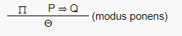
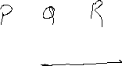


Natural Deduction
For example, one rule of our system is known as modus ponens. Intuitively, this says that if we know P is true, and we know that P implies Q, then we can conclude Q.
The propositions above the line are called premises; the proposition below the line is the conclusion. Both the premises and the conclusion may contain metavariables (in this case, P and Q) representing arbitrary propositions.
When an inference rule is used as part of a proof, the metavariables are replaced in a consistent way with the appropriate kind of object (in this case, propositions).

Slide 91
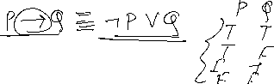
Natural Deduction
Most rules come in one of two flavors: introduction or elimination rules. Introduction rules introduce the use of a logical operator, and elimination rules eliminate it.
Modus ponens is an elimination rule for ⇒.
This is helpful when reading proofs. In this case, we have written (modus ponens). We could also have written (⇒-elim) to indicate that this is the elimination rule for ⇒.

Slide 92
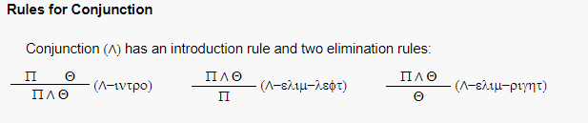
Natural Deduction

Slide 93
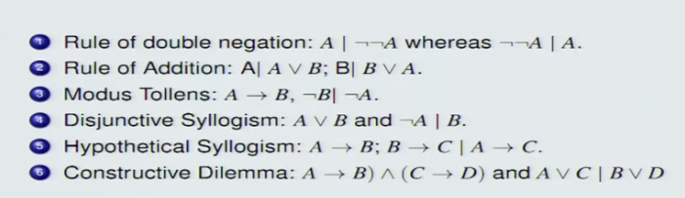

Slide 94
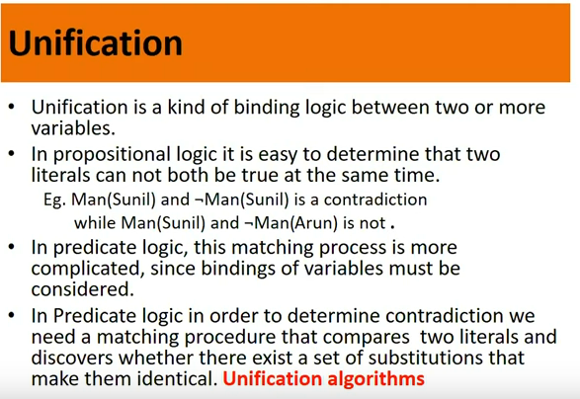

Slide 95
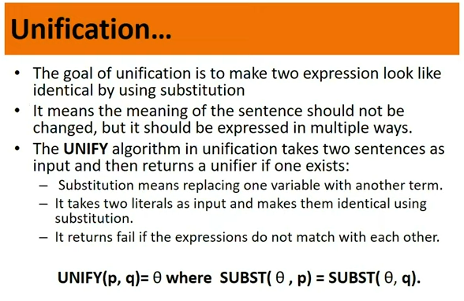

Slide 96


Slide 97

Resolution in FOL

Slide 98


Slide 99


Slide 100


Slide 101


Slide 102


Slide 103


Slide 104


Slide 105


Slide 106


Slide 107


Slide 108


Slide 109


Slide 110


Slide 111


Slide 112


Slide 113


Slide 114


Slide 115


Slide 116

Subgoal

Slide 117

Subgoal
Subgoal

Slide 118


Slide 119


Slide 120


Slide 121


Slide 122


Slide 123


Slide 124


Slide 125


Slide 126


Slide 127
First-Order Logic in Artificial intelligence
First-order logic is another way of knowledge representation in artificial intelligence. It is an extension to propositional logic.
FOL is sufficiently expressive to represent the natural language statements in a concise way.
First-order logic is also known as Predicate logic or First-order predicate logic. First-order logic is a powerful language that develops information about the objects in a more easy way and can also express the relationship between those objects.
First-order logic (like natural language) does not only assume that the world contains facts like propositional logic but also assumes the following things in the world:
Objects: A, B, people, numbers, colors, wars, theories, squares, pits, wumpus, ......
Relations: It can be unary relation such as: red, round, is adjacent, or n-any relation such as: the sister of, brother of, has color, comes between
Function: Father of, best friend, third inning of, end of, ......

Slide 128
As a natural language, first-order logic also has two main parts:
Syntax
Semantics

Slide 129

Syntax of First-Order logic:
The syntax of FOL determines which collection of symbols is a logical expression in first-order logic. The basic syntactic elements of first-order logic are symbols. We write statements in short-hand notation in FOL.
Basic Elements of First-order logic:
Following are the basic elements of FOL syntax:

Slide 130


Slide 131


Slide 132


Slide 133


Slide 134


Slide 135
Properties of Quantifiers:
In universal quantifier, ∀x∀y is similar to ∀y∀x.
In Existential quantifier, ∃x∃y is similar to ∃y∃x.
∃x∀y is not similar to ∀y∃x.

Slide 136
Some Examples of FOL using quantifier:
All birds fly. The predicate in this question is "fly(bird)." Because all birds are able to fly, it will be portrayed as follows. ∀x bird(x) →fly(x).
Every man respects his parent. The predicate in this question is "respect(x, y)," where x=man, and y= parent. Because there is every man so will use ∀, and it will be portrayed as follows: ∀x man(x) → respects (x, parent).

Slide 137
Some Examples of FOL using quantifier:
Some boys play cricket. In this question, the predicate is "play(x, y), " where x= boys, and y= game. Because there are some boys so we will use ∃, and it will be portrayed as: ∃x boys(x) → play(x, cricket).
Not all students like both Mathematics and Science. The predicate in this question is "like(x, y)," where x= student, and y= subject. Because there are not all students, so we will use ∀ with negation, so following portray for this: ¬∀ (x) [ student(x) → like(x, Mathematics) ∧ like(x, Science)].

Slide 138
Some Examples of FOL using quantifier:
Only one student failed in Mathematics. The predicate in this question is "failed(x, y)," where x= student, and y= subject. Because there is only one student who failed in Mathematics, so we will use following portray for this: ∃(x) [ student(x) → failed (x, Mathematics) ∧∀ (y) [¬(x==y) ∧ student(y) → ¬failed (x, Mathematics)].

Slide 139
Free and Bound Variables:
Free Variable: In a formula, a variable is said to be a free variable if it exists outside of the quantifier's scope. Example: ∀x ∃(y)[P (x, y, z)], where z is a free variable. Bound Variable: In a formula, a variable is considered to be a bound variable if it exists within the quantifier's scope. Example: ∀x [A (x) B( y)], here x and y are the bound variables.

Slide 140

The Wumpus World in Artificial intelligence

Slide 141


Slide 142

Atomic proposition variable for Wumpus world:

Slide 143


Slide 144


Slide 145

Prove that Wumpus is in the room (1, 3)

Slide 146

if the conjunction A and B is true, then A is true, and B is true.

Slide 147


Slide 148


Slide 149


